Slide 1
Databricks in a Day
Insight Digitial Innovation

Slide 2
Detailed Schedule
Topic | Time
Arrival and Setup | 08:30 – 9:00
Databricks Overview and Interface Walkthrough | 09:00 – 10:00
Break | 10:00 – 10:15
Labs: Read, Transform, and Explore Data | 10:15 – 12:00
Lunch | 12:00 – 01:00
Labs: Power BI (demo) and Machine Learning | 01:00 – 02:30
Break | 02:30 – 02:45
Labs: Structured Streaming and Jobs | 02:45 – 03:30
Closing | 03:30 – 04:00
Notes:
Here’s what the afternoon looks like. The break will come after the interface walkthrough. There will be plenty of time at the end of the session to ask questions and play around in the labs, yourself.
Notes:
Before jumping in, ensure that everyone has their machine up and running and they are settled.

Slide 3
Databricks Overview

Slide 4


Next, what is Apache Spark?
Pass instructions
Driver
Distribute instructions
VM
VM
VM
Cluster
Return results
Cache
Notes:
Spark is a distributed computing framework. How many of you know what distributed computing is?
Imagine you have a computer. A laptop, just like this one. On this little laptop, you’re going to you’re going to train a model. You need to process a lot of data, so it’s going to take a while. You get snacks, you make sure you have other tasks you can run in the background, a few small ones, not too many, or you’re model won’t run. You kick it off, and you wait. You check your email, you grab a snack, you IM your co-worker to tell them how long it’s taking to run the model. You eat lunch at your desk to make sure nothing crashes while you’re gone. You join a few calls. It’s 4pm and the model is still cranking. You start wondering whether you’re going to miss dinner (again), because you definitely don’t want to stop the run now. You’ve invested too much time into it. This is a common refrain for those of us who perform data manipulation or data modeling tasks on local machines or single VMs.
With Spark, instructions are still passed from a driver to a cluster, but the results are now held in “cache”.
This keeps processed data in-memory until all the instructions are complete.
Processing time is considerably faster with Spark.
***STOP FOR QUESTIONS***

Slide 5


What Databricks Provides
Performance
Ease of Use
Collaboration
Notes:
But what happens if instead of having this one laptop to churn through my model, I have all the laptops in this room to share the compute? It’s definitely going to be a lot faster. I could even use 28 of the laptops to run my model, and keep the other two open for email and local data exploration in Excel. That’s distributed computing (Spark in our case), and this is the foundation of Databricks. It provides unparalleled performance for processing large amounts of data.
Now let’s say I don’t actually need all 30 computers to have good performance. Maybe I only need 15. I’m not completely sure, but I definitely don’t want to use more than I need, because if I do, I’ll have to pay for it. I also want to make sure that when I’m done running my model, all those extra laptops shut-down. I don’t want to pay for more than I need.

Slide 6
Databricks Features We’ll Explore Today
Interactive Notebooks
Delta Tables
One-click visualizations
Spark MLLib
Structured Streaming
Power BI Integration
MLFlow
Jobs
Notes:
When you select a tool for data science, you should be thinking about the type of collaboration you will be carrying out.
For example, some teams have several technical data scientists coding together in the same environment.
In this case, it’s important to make sure there is clear record of changes that have been made to code or packages – so nothing gets broken as work circulates among teammates.
Other teams may have a collection of data engineers, business analysts, and data scientists all working on different projects in different environments out of necessity.
In this case, it is crucial that teammates don’t alter other teammates’ environments.
In many businesses, there may be a single data scientist or engineer working on a project, with a non-technical manager with read-only requirements to view outcomes of the work.
In this case, a non-technical user needs to be able to navigate both modules of the project within a workspace and peruse the work for insights.

Slide 7
Use Case
Notes:
So that’s what Databricks is all about. Now let’s talk about what we’re going to do with it today.

Slide 8

Discount Optimization
Wear It Well retail is a web retailer of men’s and women’s clothing.
Data Sources
Campaign Details
Campaign Results
Live Campaign Data
This Photo by Unknown Author is licensed under CC BY-SA
Notes:
Wear it Well is an online retailer of men’s and women’s clothing. They have a goal to increase conversion rates in their website and mobile app, and they have done some testing of different discount amounts (A/B testing) to determine which discount amounts lead to the most conversions and what that translates into in terms of sales revenue.
Over the last couple of months, they’ve been showing randomly, to different users three different discount amounts, either 0, 10, or 15 percent off. They have captured some demographical information about the users as well as whether users presented with these offers bought something and for how much.
Now they want to take that data and use it to predict which discounts lead to the highest likelihood of conversion across different types of users.
The data is currently being maintained by three different teams within the organization, and it’s not been joined together yet, even for reporting. So our task today will be to bring those disparate sources together, working as data engineers to extract, transform, and load that data. Then we’ll put on our analyst hats to answer some questions about the results of our A/B testing campaign, like do certain types of customers respond more favorably to discounts than others, and finally, we’ll work as data scientists to build a predictive model that identifies which discount should be presented to which customers in order to provide the highest likelihood of conversion (aka buying something).

Slide 9
Interface Walkthrough
Notes:
Now we will take a walk through the Databricks interface.

Slide 10
Connecting to Data
Notes:
For our first several labs, we will be working as Data Engineers, connecting to and preparing data for use by Wear it Well’s marketing analyst and data science teams. First, let’s discuss how to connect to data in Databricks.

Slide 11
How do I interact with data using Spark?
Languages
PySpark
Scala
Python
R
SQL
Bash/Powershell
Data Objects
DataFrame
Resilient Distributed Dataset (RDD)
Dataset
Notes:
There are a variety of languages that can be used to interact with Spark as well as different data objects that can be used. For today in our course, we will be utilizing PySpark and DataFrames, but know that other options are available from within Databricks if you need them.

Slide 12
A Crash Course in PySpark
Syntax
DataFrame Objects
df = spark.read.<…>
Methods
df.count() or df.select(<column?>)
Transformations
df.select(<column>).filter(<column>)
Actions
df.select(<column>).filter(<column>).count()
Lazy Evaluation
Transformations are not executed until an action is called.
Transformations are executed in the most efficient order.
Actions return a result and transformations only pass instructions.
Notes:
PySpark is the Spark API for Python. It allows us to send instructions to our distributed computing framework in a Python like language. There are a few distinctions between Python and PySpark, because PySpark is optimized for sending instructions that can be processed in parallel.
When you use methods, you’re using distributed computing. You can use Pandas and scikit learn, but you are not using distrubited computing.

Slide 13
Support Data
Supported Sources
Flat Files
Data Lakes
Supported Formats
CSV
Parquet
Schema Options
Inferred
Databases
Data Warehouses
Storage Containers
Event Hubs
Cosmos DB
User-defined
(considerably faster)
TXT
Excel
Default
JSON
Notes:
There are a variety of data sources and formats that are supported in Databricks. During our course today, we’ll be accessing CSV files, but you are definitely not limited to that in Databricks.

Slide 14
How to Access Data
Manual
Direct Access
Mount
Notes:
There are three ways to access data in Databricks.
Manual: You can manually upload files using the Databricks interface. This can be useful if you want to explore a new data set, or a sample of data, before bringing that data set officially into your environment.
Direct Access: You can access data where it sits through a direct read by providing access keys to the system within your code. This method requires that you know the access keys into the system. It is possible to use a feature in Databricks called Secrecy to ‘hide’ these access keys from other system users.
Mount: Mounting data is the final method for connecting today, and it is what we will be using today. When data is mounted in the Databricks File System (DBFS) it is available to all users of your Databricks workspace. This can be a great way to make data accessible to larger groups of users without providing direct access to your source systems.

Slide 15
Why Mount Data?
Secure
Accessible
Collaborative
Notes:
When you mount data, you make it available to other Databricks users. Data can be mounted from a variety of different cloud based storage containers, including Blob storage in Azure or data lakes and warehouses.
This provides accessibility to your data, without requiring you to share any access keys that you may want to keep hidden. Mounting data is an easy and safe way to make a data set available to anyone within Databricks to access, explore, transform, and model.
The data we will be working with for your course today has already been mounted into Databricks. Included in your lab folders is a Notebook that provides code for connecting to and mounting data, which you can use later if you want to explore on your own after class.

Slide 16
Transform and Load Data
Notes:
As data engineers, data transformations are a large part of our day jobs. With the power of Python, or any of the other support languages, we are able to process our transformations on data with the use of interactive and collaborative notebooks and enjoy the performance of distributed computing.
For our load today, we will be writing our transformed data to Databricks Detla tables. Before we start the labs, let’s dicuss Delta tables.

Slide 17
Databricks Delta?
ACID Transactions
Efficient Upserts
Streaming Capabilities
Schema Enforcement
Data Versioning and Time Travel
Databricks Delta
Notes:
ACID transactions: Serializable isolation levels ensure that readers never see inconsistent data.
Efficient upserts: Fine-grained updates easily handle late coming data and changing records.
High throughput streaming ingestion: Ingest high volume data directly into query tables.
Optimized data layout: Choose a data layout that suits your query patterns; Delta automatically manages the layout to reduce query latency.
Schema enforcement and evolution: Automatically handles schema variations to clean bad records during ingestion.
Data versioning and time travel: Automatically versions your data for easy rollback and lets you time travel to query earlier versions.
Execution engine optimizations: Optimizes operations with nested data types, higher order functions, range and data skew joins.

Slide 18
Power BI Integration
Notes:
We’re now going to switch to marketing analysts, and use the Delta tables created for us by our data engineers to get a better understanding of our data. This is the first time we have seen all of our disparate data sets joined together, and we have a few questions we want to answer before launching our campaign.

Slide 19
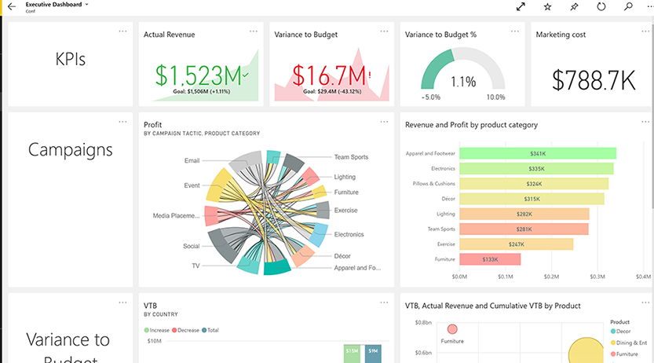
Power BI Integration
Connect to Cluster
Select Datasource
Highly Performant Dashboards
Notes:
Connecting Power BI to one of your Databricks clusters allows you to benefit from both the performance of distributed computing for your reports and directly attach to data sources that have been prepared within the Databricks environment.

Slide 20
Machine Learning in Databricks
Notes:
During this exercise, determine the level of machine learning interest and knowledge in your class and adjust your approach accordingly. See Instructor Notes for more details.

Slide 21
Databricks for Machine Learning Enablement
Collaborative Workspace
Performance & Autoscaling
Experimentation & Automation
Notes:
If you have a data science team or have worked with predictive analytics and machine learning yourself, you might be aware of some of the common problems that plague machine learning workflows.
For instance, collaborating effectively with your teammates can be challenging. Especially if you co-develop in various language, on the same pieces of code.
Machine learning, or training algorithms to learn patterns about data, is computationally intensive. While machine learning benefits from cluster computing, data scientists should be spending their time doing machine learning – not managing cluster compute resources.
Finally, machine learning is an iterative process. It requires multiple tries to “get it right” – so data scientists need a framework that fosters experimentation and easy deployment.
Databricks empowers data scientists to do what they do best – solve machine learning problems – without churning on co-development, scaling, and automation issues.

Slide 22
Databricks for Machine Learning Enablement
Collaborative Workspace
Integrated Version Control
Language Support
Environment Management
One-Click Visualizations
Notes:
Version Control
Databricks integrates seamlessly with version control frameworks Git, Bitbucket, and Azure DevOps.
In case members of your technical team are not expert users of Git or version control practices, version control activities can be performed directly in the user interface in Notebook Revision History.
Team members can comment and co-develop in real time (just like Google Docs).
Language Support
Databricks supports Python, Scala, R, SQL, and Bash/Powershell
Within notebooks, you can switch between coding languages
Environment Management
Data scientists can manage environments by managing the libraries installed on their clusters.
They can control which team members can use and edit which environments.
One-Click Visualizations
Data scientists frequently trade an discuss visualization of data during the machine learning process. Typically, these visualization have to be coded in R or Python and are time consuming to edit and clumsy to share.
One click visualizations in Databricks are in-notebook drag-and-drop and exportable visualizations. Everyone who has access to your notebooks can see visualization you’ve created, and may edit/play with them as you do.

Slide 23
Databricks for Machine Learning Enablement
Performance & Autoscaling
Machine Learning Speed
Easy Cluster Setup
Autoscaling & Transparency
Notes:
ML Benefits
Training algorithms in the cloud speeds up arithmetically heavy operations
Easy Cluster Setup
Databricks takes ~5 mins to spin up a cluster
When setting up a cluster, you can specify the compute for your nodes, and a min-max range of how many nodes you think you may need.
You do not have to be precise!
Autoscaling & Transparency
When using cluster computing, you only pay for what you use. Databricks manages scaling your cluster up and down, based on the workload running on the cluster.
You may never need to investigate how Databricks does this – but if you want to, the cluster logs in the Databricks interface allow you that transparency

Slide 24
Databricks for Machine Learning Enablement
Experimentation & Automation
Spark MLlib
MLflow
Jobs
Notes:
Now that we understand how data scientists use the UI and clusters, let’s talk about the experimentation and automation components that give machine learning algorithms legs to run.
Spark MLlib
Databricks supports Spark’s machine learning library, which is a collection of powerful algorithms that are programmed to train in a distributed computing framework.
Mlflow
MLflow is a relatively new addition to the Databricks suite of components. I graduated to public preview in February 2019.
It provides UI for logging parameters, code versions, metrics, and output files
Data scientists can save models and load them with flexibility onto popular cloud platforms.
You can capture model runs from nearly every machine learning library are supported by “flavors” (Tensorflow, PyTorch, Keras, Scikit Learn, Carets)
Jobs
Generally, you can use jobs to automatically run any notebook.
For machine learning, call any model from Mlflow in any notebook – and schedule that notebook as a Job
This enables you to make predictions automatically – which can then be deployed to Azure ML Services, an external API, or write to a data storage account/warehouse/database/lake.

Slide 25
Structured Streaming
Notes:
Let’s take a look at how you can work with Streaming data in Databricks.
Make sure everyone in the class knows what streaming data is, and if not, give them an overview.

Slide 26
Structured Streaming
Ingest Streaming Data
Create Dataframes
Join, explore, process, and visualize
It’s just another table
Notes:
When working with streaming data in Databricks, Structured Streaming makes it so you can work with that data and create DataFrame objects that can be manipulated like any other table in Databricks. You can perform many of the same operations we have already performed throughout the course, with the data updating in real-time as it changes from in the stream. This streaming data source can then be inserted into a Delta table for access by your analysts, dashboards, and data scientists, allowing for real-time dashboards and predictions.

Slide 27
Closing
Notes:
Thank you for taking the time to learn with me today. If your sales or alliance helpers are present, see if they want to make any closing remarks.

Slide 28
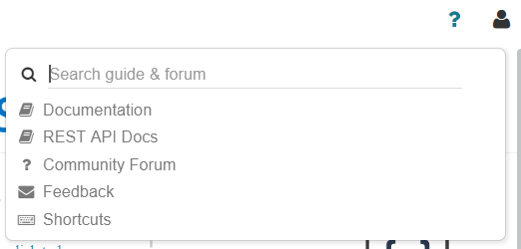
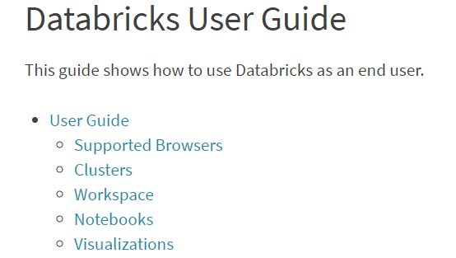
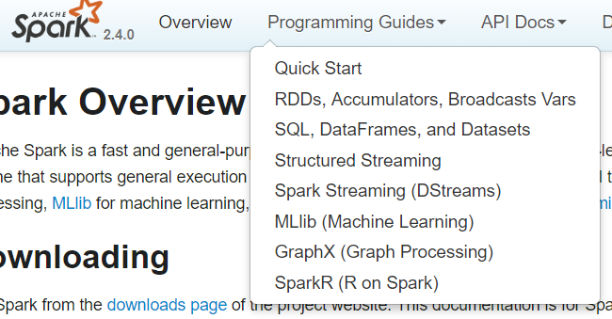
Have questions about Apache Spark or Databricks?
The Databricks UI Help Menu & Search
The Databricks Guide
https://docs.databricks.com/user-guide/index.html
Apache Spark Docs
http://spark.apache.org/docs/latest/index.html
Notes:
Databricks comes with a variety of tools to help you learn how to use Databricks and Apache Spark effectively.
Databricks holds the largest collection of Apache Spark documentation available anywhere on the web.
There are two sets of resources that we make available: resources to help you learn how to use Apache Spark and Databricks and resources that you can refer to if you already know the basics. To access these resources at any time, click the question mark button at the top right-hand corner.
The Databricks Guide is the definitive reference for you and your team once you've become accustomed to using and leveraging Apache Spark.
It allows for quick reference of common Databricks and Spark APIs with snippets of sample code.
The Guide also includes a series of tutorials that provide a more guided introduction to a given topic.
The Apache Spark Documentation is also made available for quick and simple search if you need to dive deeper into some of the internals of Apache Spark.

Slide 29
Questions/Thank You slide

